Slide 1
Millets Price Prediction
Team Details:
ABDUL SHERAZ K R
NAVEEN KUMAR THIPPIRISHETTY
PRADEEP SANCHANA
SANDESH RAMESH KANNUR
VAISHNAVI K
Mentor :Narayana D

Slide 2

Business Problem
Agriculture is Important sector in the Indian economy as it contributes around 16% of India’s GDP
Global demand for food is anticipated to increase by 60% by 2050
70% of its rural households still depend primarily on agriculture, with 82% of farmers being small and medium farmers
India is highest producers Millet across world

Slide 3

Problem Definition
Predicting Finger Millet prices will be useful for farmers
Price behavior of a commodity plays crucial role in farm-level crop production planning that includes Transportation, Storing and estimation of right price for crop.
Data Collection

Slide 4
Value addition
Beneficiaries
Solution would help find the correlation between the crop, price across different cities.
The complex value chain, lack of resources and connectivity adds to agricultural inefficiency
There is a need to provide small scale farmers with enough information so that they get the best price for the yield.
Creating a generic Model which can predict price of any Cereals, Pulses and Millets
Soil analysis and weather can be combined with this solution to recommend best crop for the farmer to get increased ROI
Small scale farmers are the primary beneficiary.
Price Prediction would assist the Business consumers ( Millet as primary ingredient ) ex: Ragi Malt
Price Prediction would assist the Business consumers ( Millet as primary ingredient ) ex: Ragi Malt

Slide 5
Methodology
Download raw dataset of Price of Millets
Clean and Process data for Feature extraction
Split the data into Train and Test data set
Test the model using Test dataset
Train and Validate the model using training dataset
Build the Machine Learning Model
Model Performance Evaluation
Predict the price for next week

Slide 6
Suggested Solution
We are attempting to forecast millet price using statistical time-series modeling techniques like Gated Recurrent Unit (GRU) and Long Short Term Memory(LSTM), which in on Recurrent Neural Network(RNN) models.
The forecasting performance of these models has been evaluated and compared by using common criteria such as Mean Square Error.
Both LSTM and GRU helps in keeping relevant information and pass it forward

Slide 7
Data Collection
Exploratory Data Analytics
Collected more than 15 years (2001 to 2019) of data from Data.gov.in (Indian government data website) on Finger Millet and other few millets.
Identify if there is missing values
The Data has State wise, District wise, Commodities (Finger Millet, Sajje etc.), Variety, Arrival Date, Min Value, Max Value, Model Price ( All values are per 1 ton)
Since this is time series data , we need to ensure we rearrange the data in order
For Computation we have chosen data from 2014 to 2019 for Finger Millet of 2 cities ( Bangalore and Mysore) for only Fine Variety
Using Asfreq we have set the frequency of data as Date wise
Since the data is available year wise data we had to consolidate the data in one sheet
Missing data found are being filled using Forward fill

Slide 8
Challenges
Data Collection
Since the data is not available in one place, we need to collate many sheets to get the desired data.
Model complexity increase when we increase number of features ( Cities, Variety, Commodity)
The duration of building the model based on the features also keep vary

Slide 9
Algorithms and Solution
There are two basic types, which we can solve the price prediction problem using Structural and Time-Series.
RNN's (LSTM's) are pretty good at extracting patterns in input feature space, where the input data spans over long sequences
The GRU is the newer generation of Recurrent Neural networks and is pretty like an LSTM
Pre processed done to rearrange the data in such a way that each column represents 1 feature of a city.
Since this is Time series data we have kept latest 25% of data for testing with the training data we’re scaling the values to 0,1 using MinMaxScaler.
Standardization is useful for data which has negative values. It ​arranges the data into normal distribution.

Slide 10
Algorithms and Solution
Error calculated using Mean Square Error and model is trained using Adam Optimizer
Final Dense layer added to extract 2 features ( 2 cities)
Trained the model with 20 Epochs
Test data used to validate and predict the results based on training data

Slide 11
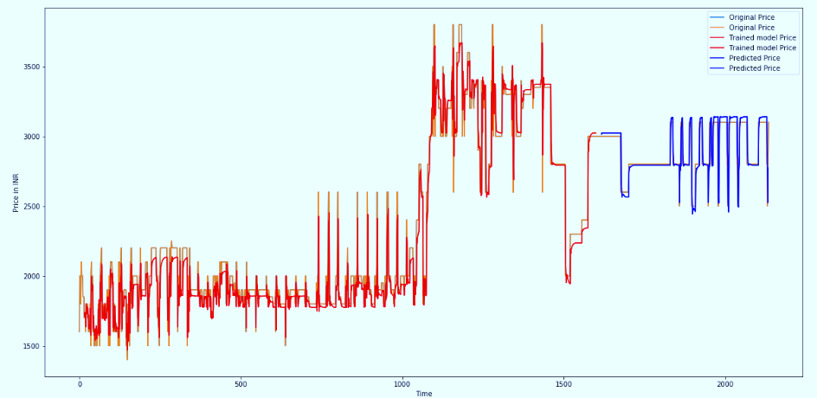
Results
With using a split of training 75% and test 25%, below are the results.

Slide 12
Steps to take it to Production
Potential Projects
Building a Pickle file
Soil Analysis
Deploying the Model to the Cloud Environment (AWS/Google Cloud/Azure)
Weather Prediction
Build REST API Services
Create Mobile Application

Slide 13
Conclusion
In recent years, great efforts have been undertaken on the challenging task of predicting Millet price. Developing accurate models for predicting price using Information and Communication Technologies may help farmers and other stakeholders improve decision making in relation to national food import/exports and food security. In future we can add more features such as comparison of different non-perishable crops and add more regions to find correlation of price variation to improve the accuracy of price prediction. The most important factor for successful prediction would be high-quality and up-to-date data.

Slide 14
Thank you!
All the best for your Journey in Data Science

